Slide 1
5. Synchronised Candles
5. Synchronizované sviečky
34th IYPT 2021

Slide 2
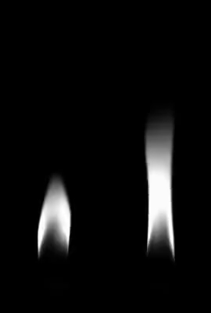
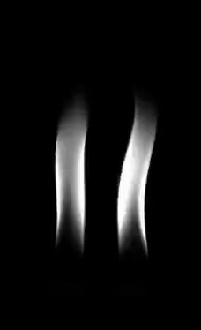
5. Synchronised Candles
Oscillatory flames can be observed when several candles burn next to each other. Two such oscillators can couple with each other, resulting in in-phase or anti-phase synchronisation (depending on the distance between the sets of candles). Explain and investigate this phenomenon.
anti-phase
synchronisation
Slow motion video
~ 15x (11 Hz)
in-phase
synchronisation
[Chen2019]

Slide 3
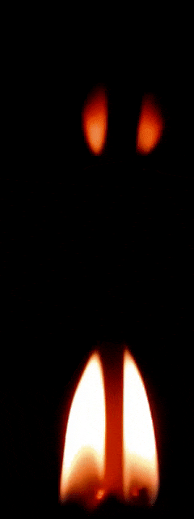
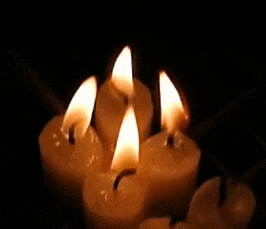
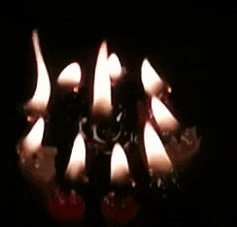
Candle oscillators
Several candles –> oscillatory flames = > at least 2 candles in bundle - > candle oscillator
2 candles
4-candles oscillator
10-candles oscillations
[Forrester2015]
Applications in combustion engines for aerospace,
combustion processes in chemical industry

Slide 4
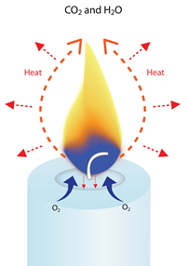
Physics of candle
Wax (paraffin) – hydrocarbons - fuel melting point 40°C – 90°C
liquid wax is drawn up the wick by capillary action
vaporized hydrocarbon molecules react in flame with oxygen from the air to create heat, light, water vapor (H2O) and CO2.
convection
Normal gravity on Earth
in microgravity
Convection draws hot wax vapors out from the wick and sucks oxygen from the surrounding air into the base of the flame.
Conduction carries heat down the wick to melt more wax at the top of the candlestick (it also carries down into the solid base of the candle).
The flame gives off heat also by IR radiation and thermal diffusion.
Glowing part of the flame radiates ¾ of its energy as light.

Slide 5
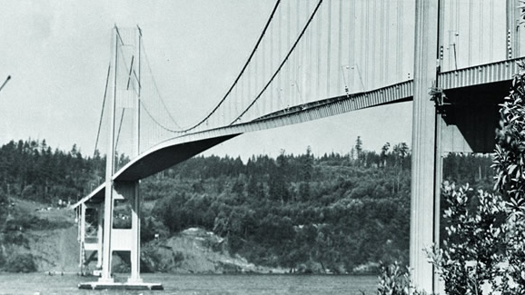
Candle oscillator
Self – oscillations
Limit- cycle oscillations
Complex non-linear problem
Nonlinear oscillations – flame brightness / height
Possibly not only by periodic lack of oxygen, but also by the convection vortices over the flame.
[Forrester2015]
Other examples of non-linear self-oscillations
Tacoma
Narrows
Bridge
Tree leaves dancing in the wind

Slide 6
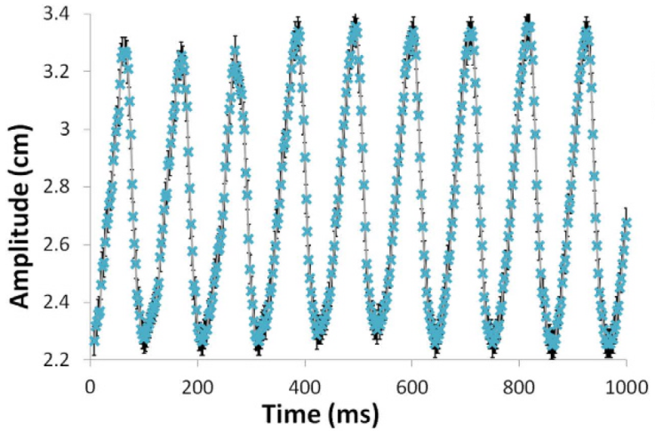
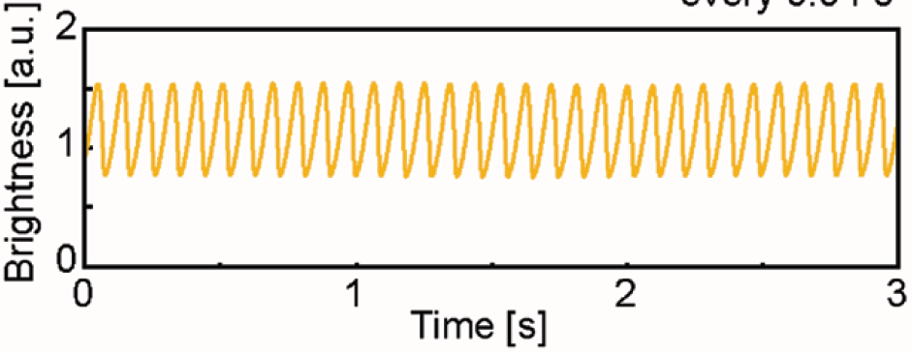
[Forrester 2015]
From experiments:
frequency gradually decreases as the number of candles increases in case of isolated oscillator
[Kitahata2009]

Slide 7
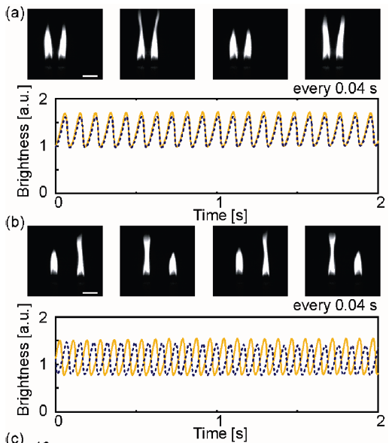
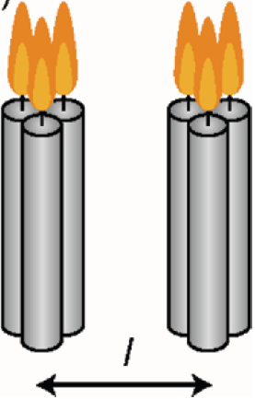
In-phase and anti-phase synchronisation on closer and larger distances
[Kitahata2009]
in-phase synchronisation 2 -3 cm
antip-hase synchronisation 3- 5 cm
~ 10 -13 Hz
desynchronisation > 5cm
Notes:
Amplitude depth - is the complete quenching of oscillations due to a coupling between the different flames. Another phenomenon is phase-flip bifurcation, which is an abrupt change from in-phase synchronisation to out-of-phase synchronisation.

Slide 8
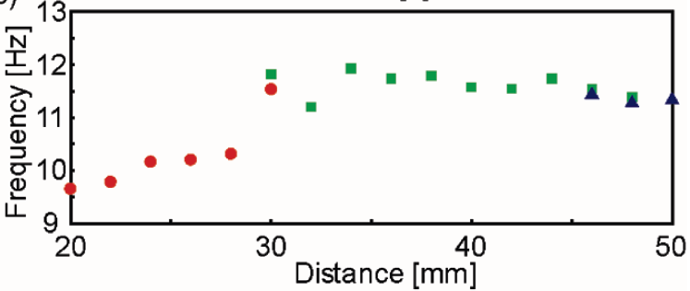
At D ~ 3cm two modes coexist and frequency of oscillations jump.
[Kitahata2009]
What is the coupling between the two oscillators ?
Heat transfer via convection, thermal diffusion , radiation.
The coupling between oscillators is dominated by thermal radiation.
Thermal diffusion is too slow for synchronisation of oscillation with period ~0.1s.
Not via convection – no lateral air flow between oscillators. But …
Turbulence occurrence above the flames and convection flow not included in model

Slide 9
Quantitative model
Radiation interaction
$$σ\frac{μ}{L^{2}}\left(T_{j}^{4}−T_{i}^{4}\right)$$
i,j = 1,2 (i ≠ j)
T(t) temperature of the flame
n(t) oxygen concentration in air
[Kitahata2009]
C specific heat
R gas constant
E activation energy
T₀ ambient temperature
n₀ ambient oxygen concentration
h heat flow by convection
k oxygen supply rate by convection
β heat production in combustion
σ Stefan-Boltzmann constant
ω₁ temperature time constant
ω₂ oxygen change time constant

Slide 10
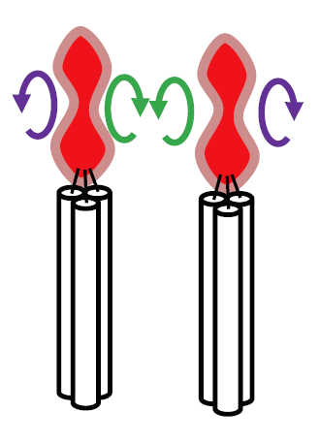
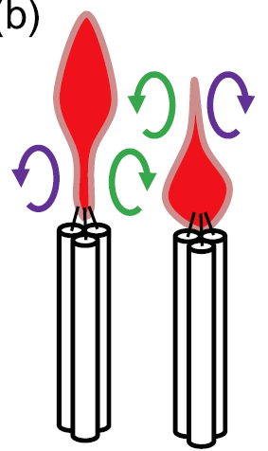
Recent reports provide evidence on the presence of intermediate
“amplitude death” mode located between in-phase and antiphase modes – no oscillations.
Another mode : phase-flip bifurcation - sudden transition from in-phase to anti-phase
Role of time delay coupling [Manoj 2018]
With increase in number of candles in an oscillator, they observed a considerable reduction in the “amplitude death” zone.
Domination of fluid mechanics
Formation, evolution and detachment of toroidal vortices along flame sheets
Vorteces above the flame could affect synchronisation.
Closer distance – in-phase – unified vortex formed
Farther apart – anti-phase – two independent vortices

Slide 11
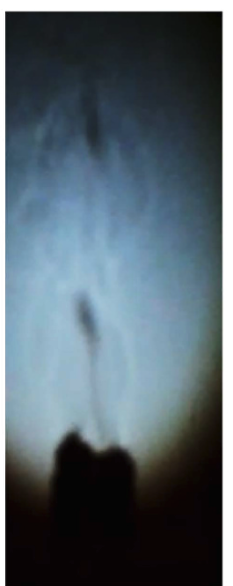
Experimental setup at “home” conditions
Dark background
Dark room
No air flow
Room T
For high speed video use smartphone with video capture mode “slow motion” with at least 120fps, better above 200fpd.
Video capture
Try shadow video capture using stronger light projection on the white screen
In order to avoid transient effects let the oscillators reach a steady state - after each distance change apply waiting time e.g. 20s.
Fresh candle might need several minutes to stabilize.
Stronger light source
Recommendation:
pre-burn your test candles, then the time for steady state can be shorter.

Slide 12
- wait few minutes after ignition for combustion process to stabilize
flame may flicker or smoke initially
After stabilisation the flame of single candle will burn cleanly and steadily in a teardrop shape.
Flickering can be caused by
impurities in the wax interrupting the flow in the wick,
by a draft in the room,
getting either too much or too little air or wax.
the too long wick
(wax has to travel a length that affects the stability of the flame)
Assuming stable conditions
single candle should not flicker,
no external interference – draught in the room, dust, etc

Slide 13
Experimental parameters
Distance
Number of candles in oscillator (compare to wick thickness, ratio to candle diameter)
Different number of candles in each oscillator
mass burning (loss) rate of the fuel Δm/Δt ~ ΔQ/Δt effective heat release rate
Differs in various oscillation modes?
Necessary to measure over longer time – tens of minutes
In-situ measurement on weighing scales?
Regression rate R = (Δm/Δt)(1/4 πD²ρ) [mm/min]
Flame height
Vorteces above the flame could affect synchronisation.
Closer distance – in-phase – unified vortex formed
Farther apart – antiphase – two independent vorteces
In shadow capture observation of laminar vs turbulent regions.
Inserting a barrier from above between the oscillators.

Slide 14
References
Kitahata, H., Taguchi, J., Nagayama, M., Sakurai, T., Ikura, Y., Osa, A., … Miike, H. (2009). Oscillation and Synchronization in the Combustion of Candles. The Journal of Physical Chemistry A, 113(29), 8164–8168. https://doi.org/10.1021/jp901487e
Manoj, K., Pawar, S. A., Dange, S., Mondal, S., Sujith, R. I., Surovyatkina, E., & Kurths, J. (2019). Synchronization route to weak chimera in four candle-flame oscillators. Physical Review E, 100(6). doi:10.1103/physreve.100.062204
Forrester, D. M. (2015). Arrays of coupled chemical oscillators. Scientific Reports, 5(1). https://doi.org/10.1038/srep16994
Okamoto, K., Kijima, A., Umeno, Y. et al. Synchronization in flickering of three-coupled candle flames. Sci Rep 6, 36145 (2016). https://doi.org/10.1038/srep36145
Chen, T., Guo, X., Jia, J., &amp; Xiao, J. (2019). Frequency and Phase Characteristics of Candle Flame Oscillation. Scientific Reports, 9(1). https://doi.org/10.1038/s41598-018-36754-w
Yang, T., Xia, X., & Zhang, P. (2018). Anti-phase and in-phase flickering of dual pool flames. arXiv preprint arXiv:1803.10411. https://export.arxiv.org/ftp/arxiv/papers/1803/1803.10411.pdf
Dange, S., Pawar, S. A., Manoj, K., & Sujith, R. I. (2019). Role of buoyancy-driven vortices in inducing different modes of coupled behaviour in candle-flame oscillators. AIP Advances, 9(1), 015119. https://doi.org/10.1063/1.5078674
SW for processing of video frames
Tracker https://physlets.org/tracker/
GNU Octave - a free software compatible with MATLAB
https://www.gnu.org/software/octave/index
https://iypt.ru/
https://stemfellowship.org/iypt-2021-references/synchronised-candles/

Slide 15
Thank you for your attention

